Slide 1

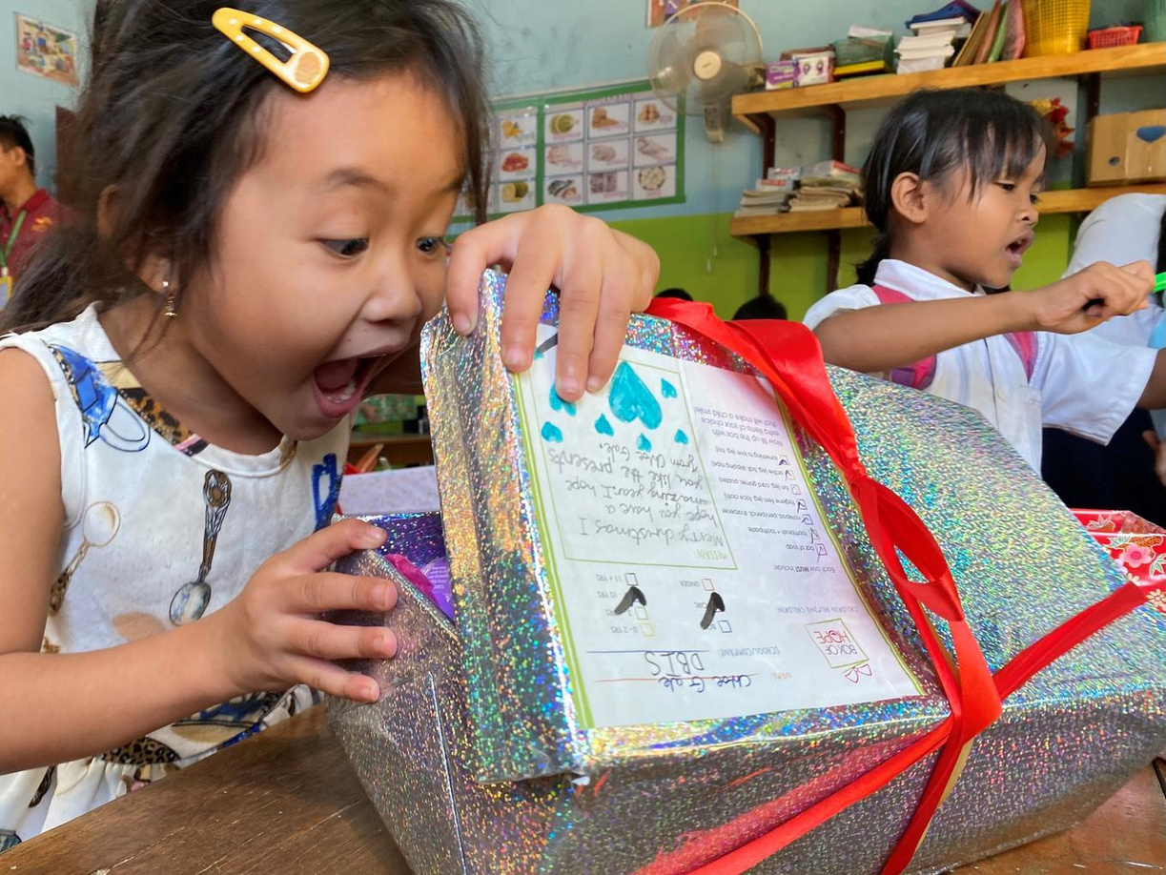

Secondary School Presentation
Campaign 2026

Slide 2
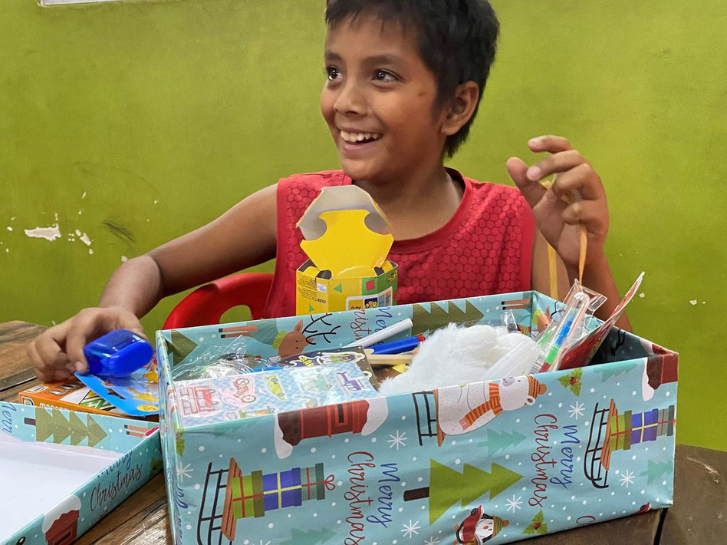
According to UNICEF, a child’s most basic rights include:
    Food, clothing and shelter.
    Identity, care and support, education
    Safety, respect, kindness
Notes:
All the kids are aware of children’s human rights as the schools cover this.
Our role comes in at the bottom row in terms of respect and most importantly kindness.
BoH has grown around kindness and generosity

Slide 3
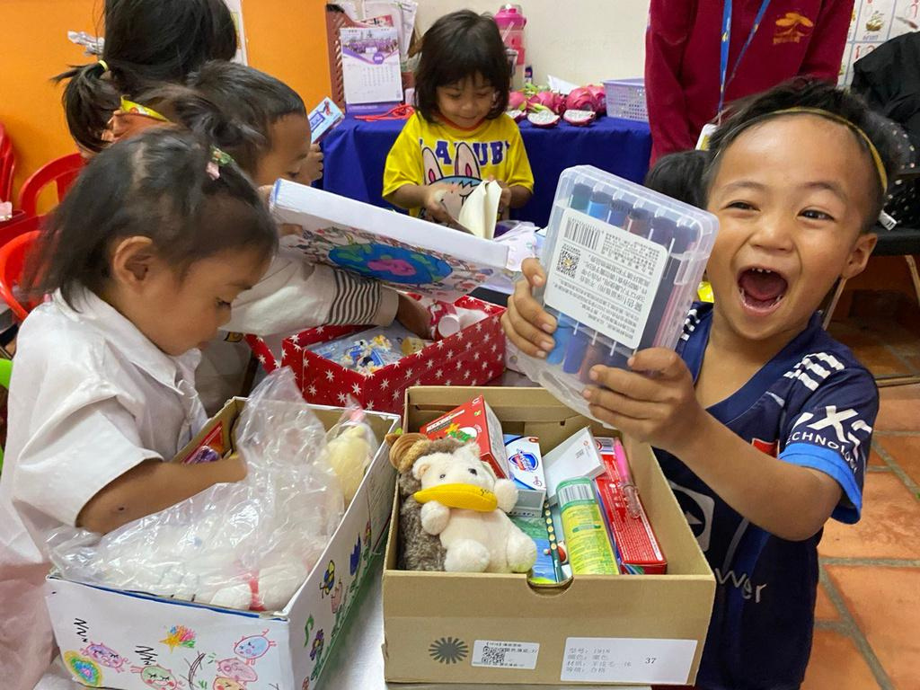
Did you know, that in Hong Kong:
    46% of people in Hong Kong live in public housing
    +/-1.39 million people do not have enough money for all the things they need.
    1 in 5 children lives in a family with a very low income.
    Families with low incomes spend almost half of their money on food.
    Poverty gap – The richest people in Hong Kong earn up to 81 times more than the poorest.
    * Info from Feeding Hong Kong, May 2025, Oxfam Q1 2024
Notes:
7.5 million people in 2024 in Hong Kong . Around 20%
5000 per month per adult - do they get money for the children (childfare??)
Can also ask how it makes them feel to receive a gift
Nice to know that somebody has thought about you in putting time in and thinking about what you’d like to receive
Now, imagine what it might feel like if you’d never received any gifts

Slide 4
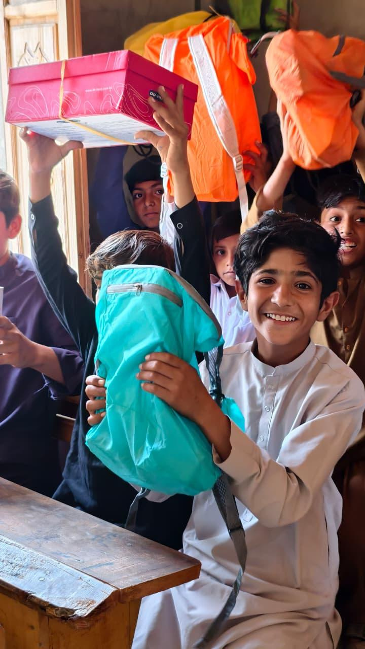
Welcome to Box of Hope
2026
We believe that EVERY CHILD, should experience the excitement of receiving a festive gift - please help us to make that happen!
Notes:
Ask the students for ‘hands up’ to see how many receive gifts for birthdays/christmas and other celebratory events.

Slide 5
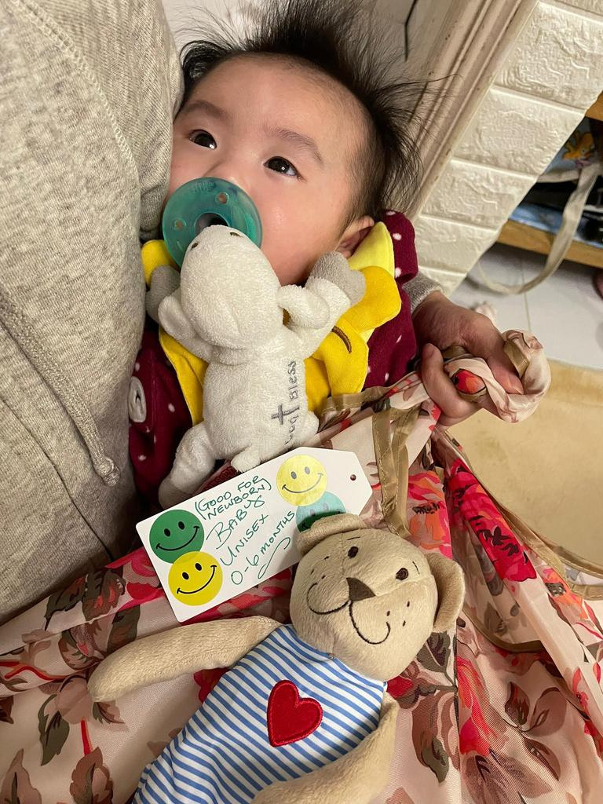
Why do we do this?
    Receiving a gift brings warmth and happiness
    Every child deserves the excitement of receiving a gift
    Children feel loved and included when their community supports them
    They truly appreciate your kindness and generosity

Slide 6
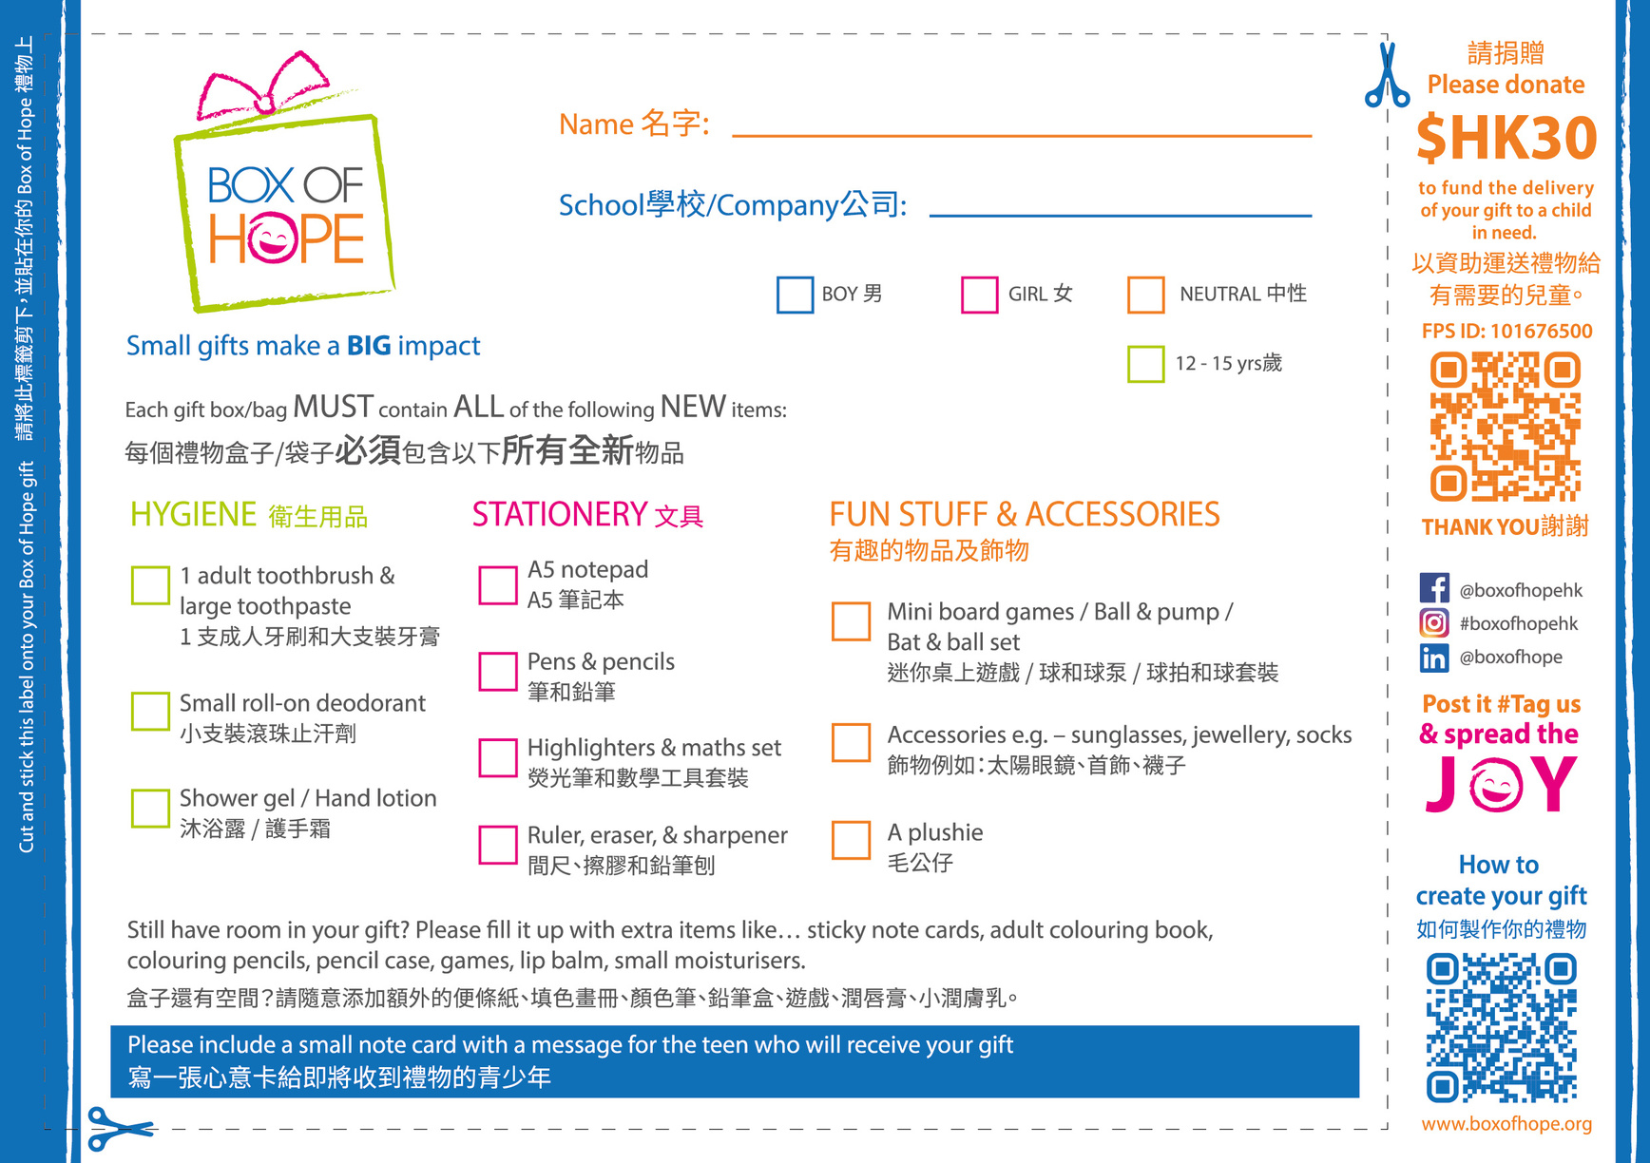
Notes:
Create a gift for a boy or girl between the age of 6 - 11 years. Create a box the same age as you are.
Adult shoe Box or Reusable bag is okay

Slide 7
VIDEO LINK FOR SECONDARY STUDENTS

Slide 8
Notes:
Create a gift for a boy or girl between the age of 6 - 11 years. Create a box the same age as you are.
Adult shoe Box or Reusable bag is okay

Slide 9
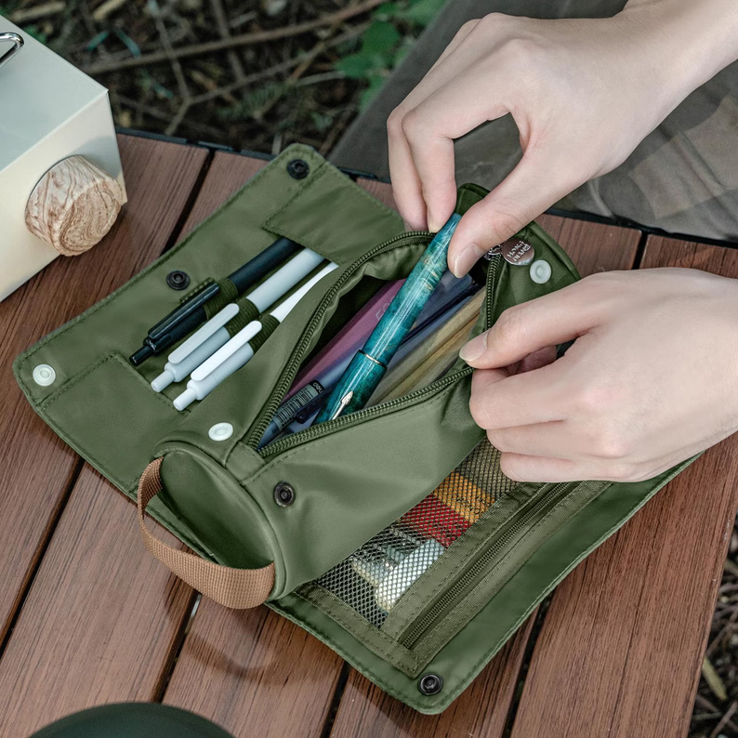

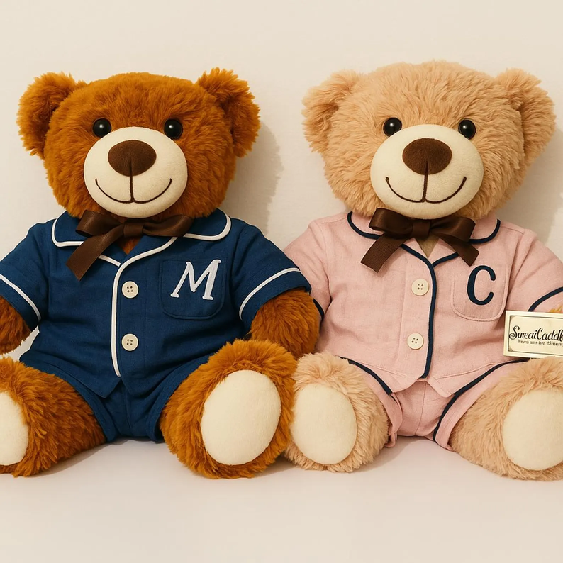
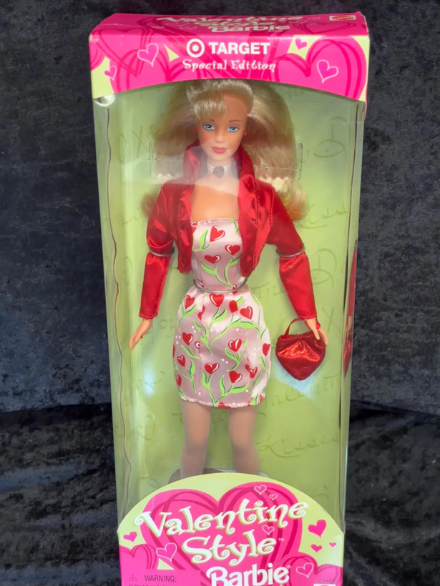

A story to tell..
HK
Social Welfare Department
Cambodian
Children’s FundCF
IBEL
Notes:
iBEL - Boy so happy first time in his live he got a pencil case. Boy around 10 to 12 years old.
visit Government Residential Care Home. Children live their because their father and Mother can’t take care of them any more. Gril 11 yeas old lived there already from her 4th. And was very happy to show my collegues around. She loves receiving a gift every year. Last year she got a plushie rabbit that was sitting on her bed. She also loves receiving stationary because she can’t really affort it. She hopes to get correction tape and a cool A5 note book.
CCF Girl around 14 to 16 years old, received first doll. We thought maybe need to switch the gift burt she was extremely happy. She never had a doll before.
‹#›

Slide 10
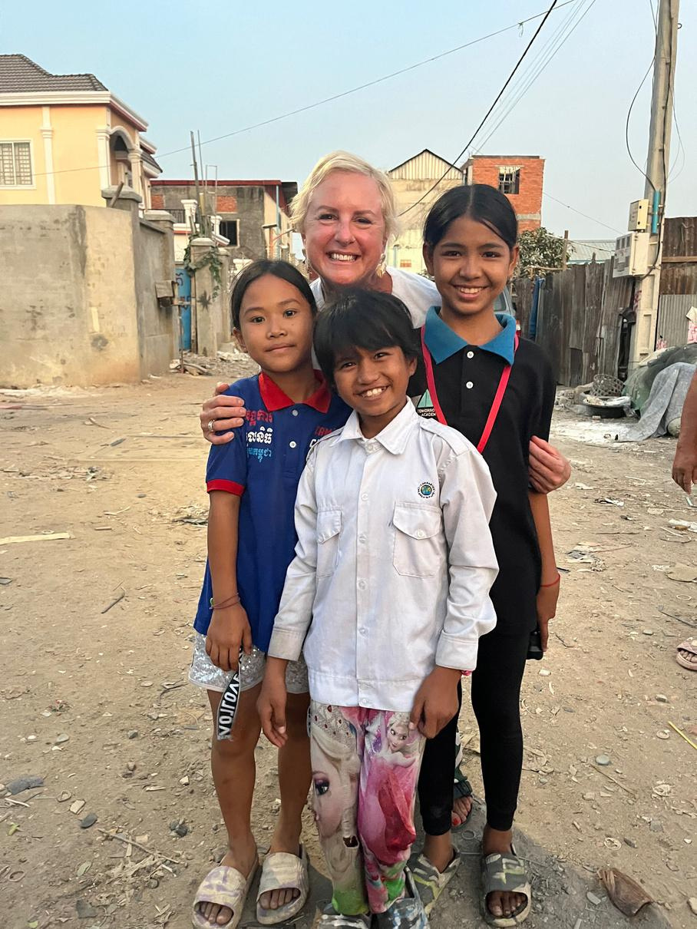
Who we support
The Charities We Support
    Hong Kong
      Refugee Union
      HK Children & Youth Services
      Christian Action
    Cambodia
      Mother’s Heart
      People’s Improvement Org
    Pakistan
      All Brothers Community Welfare
Notes:
Huge amount of gifts, majority 96% donated by HK school students
Worked with charities in Hong Kong, Vietnam, Cambodia, Philippines and Pakistan
All HK schools – approx 96% of donated gifts come from schools
Every year we need help from volunteers to check all of the gifts before they are sent out to the children
If the school has supported us in previous year, good to let them know their contribution.
‹#›

Slide 11
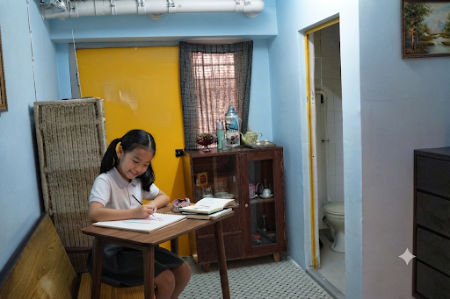
Meet Annie……
She’s 11 years old and lives with her Mother in Sham Shui Po, in a subdivided apartment.
She loves drawing and making handicrafts, but her Mum can’t afford to buy her these items.
Annie received a Box of Hope gift last year - when she opened her gift, she instantly broke into a big smile. Inside was exactly what she needed — a cute Cinnamoroll doll, and stationery such as pencils, erasers, and a notebook.
For her, the gift was a little bundle of light and encouragement that made her feel truly seen and cared for.
Notes:
Story from SoCo

Slide 12

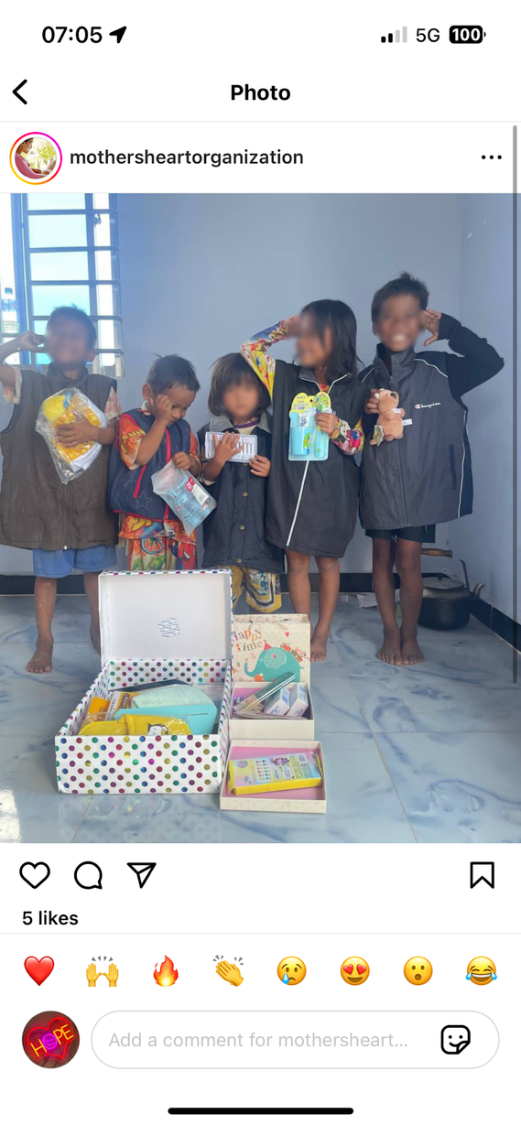
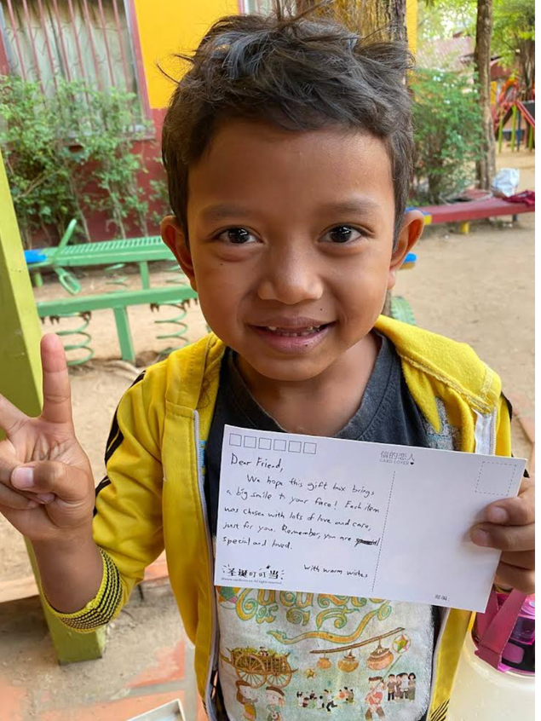
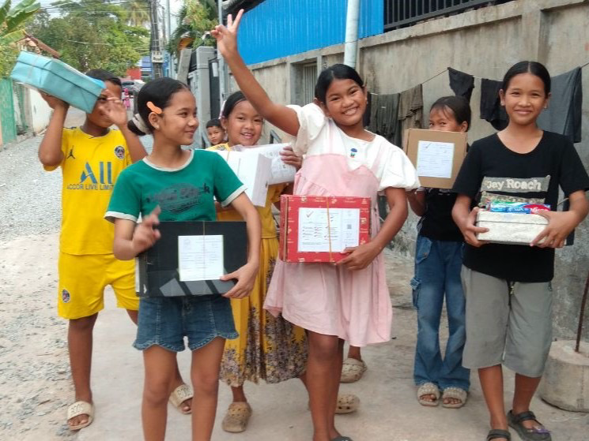
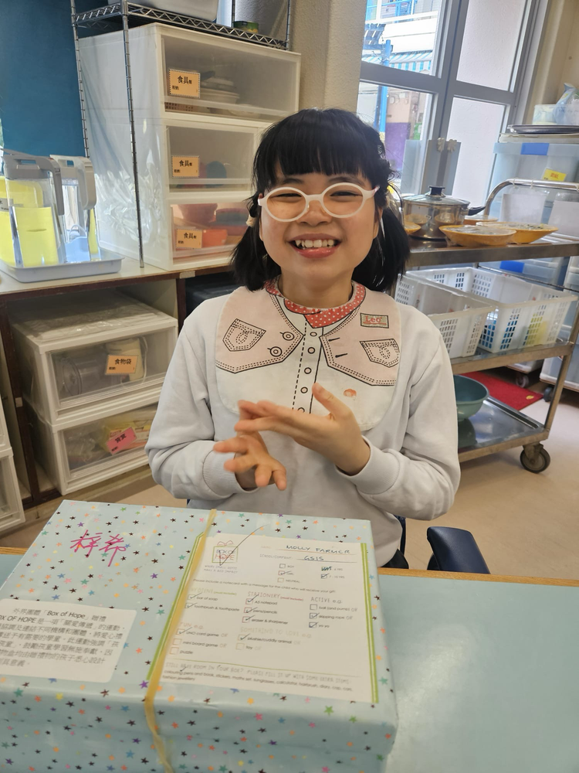
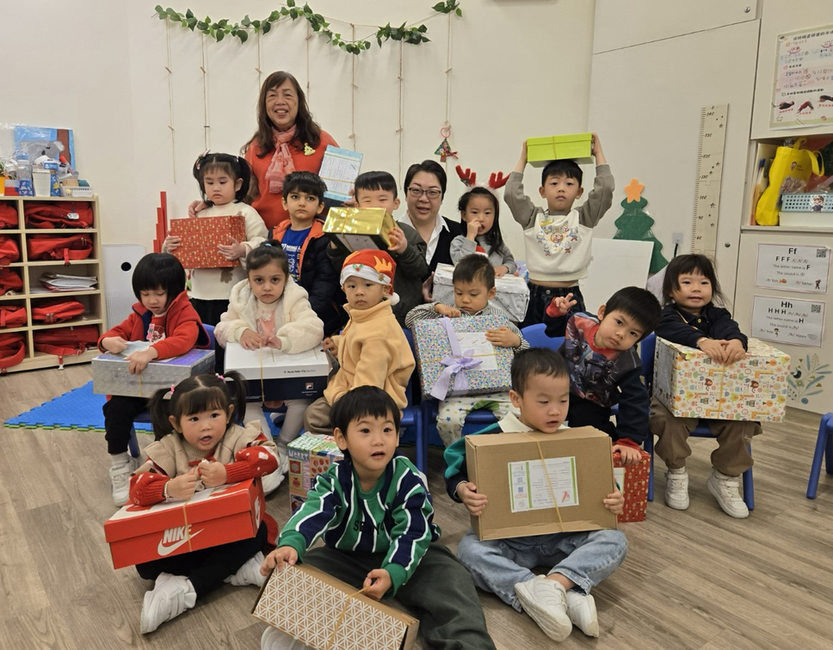
Smile!!!!
Notes:
iBEL - Boy so happy first time in his live he got a pencil case. Boy around 10 to 12 years old.
visit Government Residential Care Home. Children live their because their father and Mother can’t take care of them any more. Gril 11 yeas old lived there already from her 4th. And was very happy to show my collegues around. She loves receiving a gift every year. Last year she got a plushie rabbit that was sitting on her bed. She also loves receiving stationary because she can’t really affort it. She hopes to get correction tape and a cool A5 note book.
CCF Girl around 14 to 16 years old, received first doll. We thought maybe need to switch the gift burt she was extremely happy. She never had a doll before.
‹#›

Slide 13
VIDEO LINK - CCF 2023

Slide 14
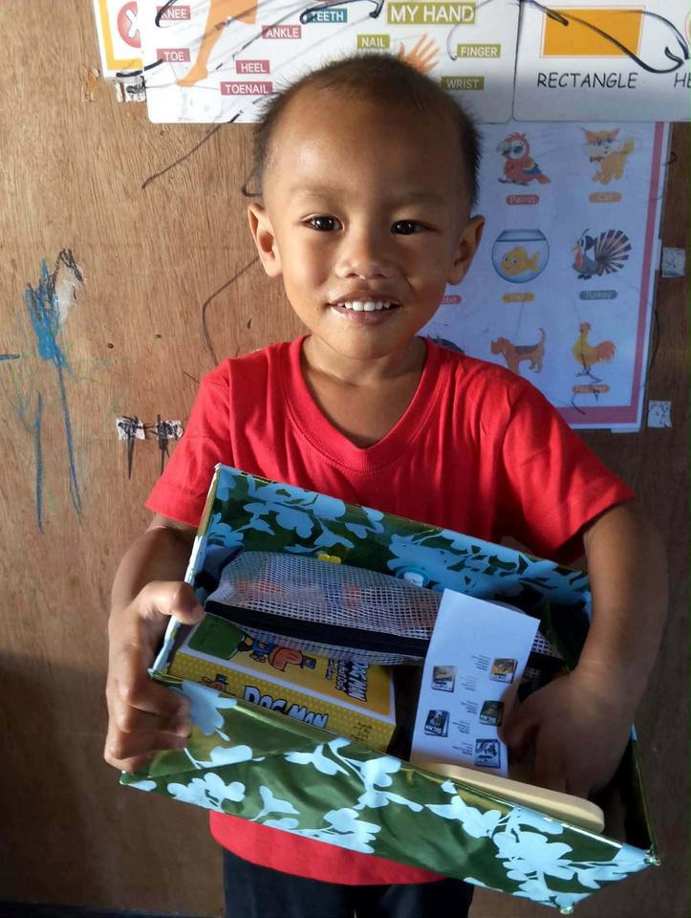

THANK YOU!!
We couldn’t do what we do, without you!

